Slide 1
Funding for the Washington Metropolitan Area Transit Authority
Fairfax County Federation of Citizens Associations
October 24, 2024
Brent Riddle, Department of Transportation
Fairfax County Government

Slide 2
Funding for the Washington Metropolitan Area Transit Authority
Overview: Funding for WMATA
Funding for Capital Projects
Funding for Operating
  Metrorail, Metrobus, and MetroAccess
  Hot-Button Issues
  DMV Moves/SJ28
  Revised Metrorail & Metrorail Formulas

Slide 3
Overview: Funding for WMATA
Members of the WMATA Compact (Washington DC, Maryland, & Virginia) provide capital and operating fund support to WMATA on an annual basis
  Alexandria, Arlington, City of Fairfax, Fairfax County, Falls Church, and Loudoun
Each jurisdiction determines how to fund WMATA
  A combination of local, state, and federal (Section 5307) funds are used
Other sources of revenue include fares, advertising, joint development, Passenger Rail Investment and Improvement (PRIIA) funds, and other federal grants
In 2018, the Commonwealth of Virginia passed legislation that capped the growth of WMATA operating expenses at 3% annually and provided an additional $154.5M for state of good repair capital each year

Slide 4
Funding for Capital Projects
Metro’s current Capital Improvement Program is an $11.1 billion, six-year program (FY 2025 – FY 2030)
Addresses state of good repair needs; modernizes trains and equipment to provide safe, efficient, and reliable service; enhances safety and reliability through maintenance, rehabilitation, and replacement programs.
Investments include the replacement of bus and paratransit vehicles; deployment of mobile fare payment systems and fare gate replacements; and expanding the acquisition of new 8000-Series railcars.
Other investments include developing the zero-emission bus program; rehabilitating existing railcars and buses; constructing new bus garages; replacing fare boxes; investing in equipment to prepare for an advanced signaling system; and making improvements to and rehabilitating rail stations, tunnels, bridges, track signals, and bus system infrastructure.

Slide 5
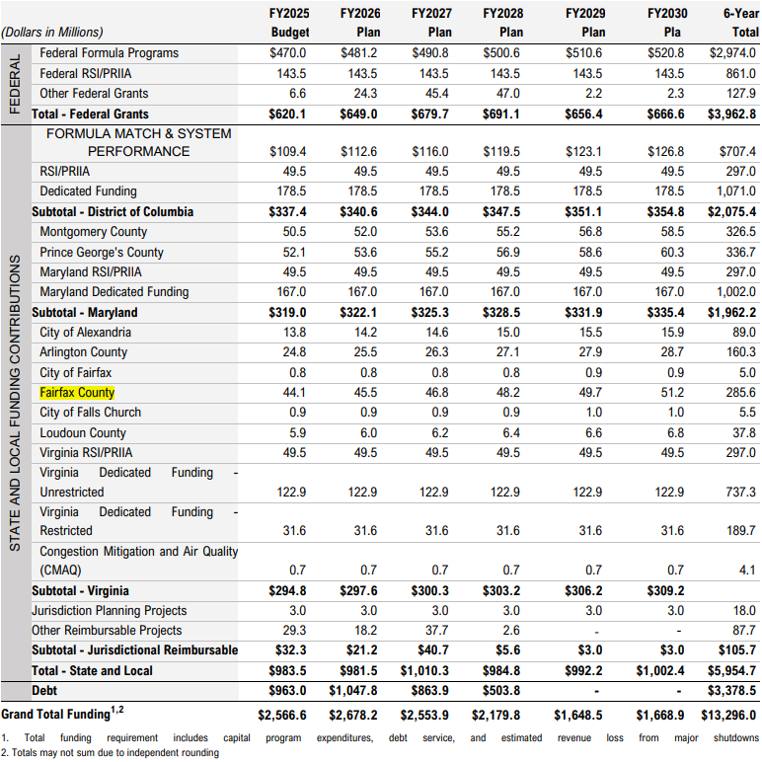
Funding for Capital Projects
WMATA Capital Improvement Program Budget

Slide 6
Funding for Capital Projects
County General Obligation Bonds
General Obligation bonds require voter approval
The “Full Faith and Credit” of Fairfax County is irrevocably pledged
Ratings History
  Aaa from Moody’s Investor Services since 1975
  AAA from Standard & Poor’s (S & P) since 1978
  AAA from Fitch since 1997
Elite rating category that consists of the following as of January 2024
  12 out of 50 States
  53 out of 3,069 Counties
  37 out of 35,000+ Cities and Towns

Slide 7
Funding for Capital Projects
County Referenda Overview
Current Referenda Plan
  County – even numbered calendar years
  Schools – odd numbered calendar years
  November 2024: Transportation $180 million & Public Safety $126M
Sunset Rule
  All referenda expire in eight years from date of voter approval
  Two-year extension permitted upon petition to Circuit Court
Citizen approval rates average in the low 70% range
  School Bond November 2023 - 67% app

Slide 8
Funding for Capital Projects
County Transportation Bond Question
Shall Fairfax County, Virginia, contract a debt, borrow money, and issue bonds, in addition to the transportation improvements and facilities bonds previously authorized, in the maximum aggregate principal amount of $180,000,000 for the purpose of financing Fairfax County’s share, under the Washington Metropolitan Area Transit Authority Compact, of the cost of constructing, reconstructing, improving, and acquiring transportation improvements and facilities, including capital costs of land, transit facilities, rolling stock, and equipment in the Washington metropolitan area?

Slide 9
Funding for Capital Projects
Proposed January 2025 General Obligation Bond Sale
Authorization provided from prior year bond referenda approvals
Amounts are then included as part of the County’s annual General Obligation Bond Sale
Planning a $400 million bond sale mid-January 2025
  Schools $230 million
  County $170 million

Slide 10
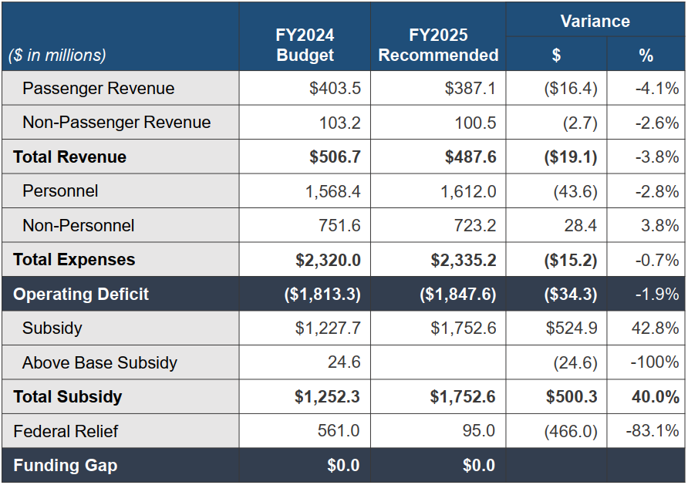

Funding for Operating
FY 2024 & FY 2025 WMATA Budget Overview

Slide 11
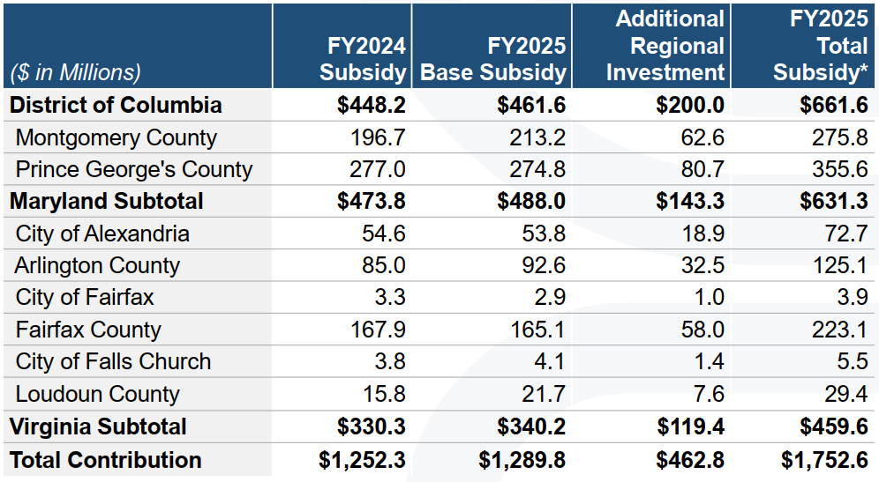

Funding for Operating
FY 2024 & FY 2025 WMATA Subsidy Table
  Fairfax County Allocation - $223.1M
  Virginia Allocation Subtotal - $1,752.6M

Slide 12
Funding for Operating
Fund 30000 Metro Operations and Construction
FY 2025 Operating Expenses
  Metrorail
  Metrobus
  MetroAccess (Paratransit)
  FY 2025 Revenue Sources
  General Funds
  State Aid
  Gas Tax
  Interest

Slide 13
Hot-Button Issues
DMV Moves - A joint initiative by the Metropolitan Washington Council of Governments (COG) and the Washington Metropolitan Area Transit Authority (WMATA) to develop a unified vision and sustainable funding model for public transit in our region.
Task Force
  Paul Smedberg (Task Force Co-Chair)
  Virginia Members: Chairman McKay, Board Member Matt De Ferranti, Chair Phyllis Randall, Deputy Secretary Michael Sargent, Delegate Mark Sickles, Senator Scott Surovell
  Government Partners Advisory Group
  County Executive Bryan Hill (Chair)
  Chief Administrative Officers of all COG member governments, local and state transit agencies, NVTA, NVTC, MWAA, and DRPT
  Community Partners Advisory Group

Slide 14
Hot-Button Issues
  SJ 28 – A joint subcommittee to study long-term, sustainable, dedicated operating and capital funding as well as cost-containment controls and strategies (WMATA-only) for the Washington Metropolitan Area Transit Authority, the Virginia Railway Express, and the public transit systems that serve the NVTC and Potomac and Rappahannock Transportation Commission (PRTC) transportation districts.
  Members of Senate Finance and Appropriations (3 – Senators Ebbin, Boysko, and Surovell)
  Members of House Appropriations (2 – Delegates Sickles and Austin) and House Transportation (2 – Delegates Delaney and McClure)
  Member of the WMATA Board of Directors (Smedberg)
  Member of NVTC (Supervisor Alcorn)
  NVTC Executive Director or designee
  Secretary of Transportation or designee
  Technical Working Group supports this effort.

Slide 15
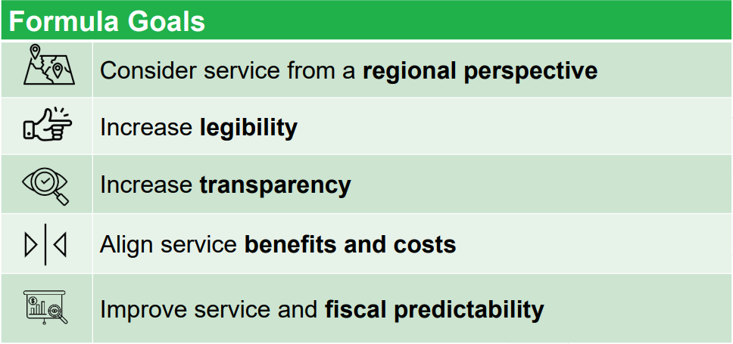
Hot-Button Issues
  Revised Metrorail and Metrobus Formulas
  Metrorail: Last revised 1995 – Added maximum rail fare subsidy
  Metrobus: Last revised 1998 – Board adopted current formula

Slide 16
Questions?

